Slide 1

Communication Access Now

Slide 2
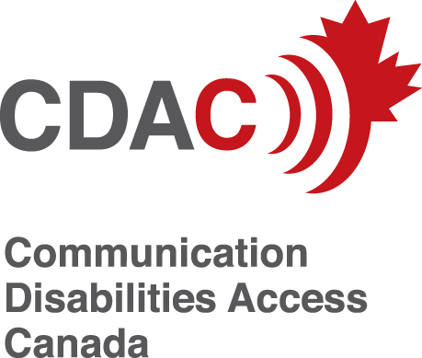
Communication Disabilities Access Canada
CDAC is a national, non-profit organization that promotes social justice, accessibility and inclusion for people who have speech and language disabilities, not caused by hearing loss.
www.cdacanada.ca

Slide 3
Communication Access Now
These slides and resources were developed by CDAC as part of its CAN project.
CDAC gives permission for their use however, CDAC is not responsible for content provided by the presenter.

Slide 4

Video

Slide 5
Communication Access Now (CAN)
National Campaign to raise awareness of communication access of people with speech and language disabilities, not caused by hearing loss (2013- 2016)

Slide 6
Communication Access Now
Operated by Communication Disabilities Access Canada
Funding contribution from the Government of Canada’s Disability Component of the Social Development Partnerships Program (SDPP-D)

Slide 7
People with Speech and Language Disabilities
440,000 Canadians have speech and language disabilities that are not caused by hearing loss.
They may have cerebral palsy, autism, cognitive disability, traumatic brain injury, aphasia after a stroke, dementia, Amyotrophic Lateral Sclerosis, Parkinson’s disease, Multiple Sclerosis or other conditions.

Slide 8
One Size Does Not Fit All
Disabilities can affect people in different ways:
Speech – unclear or no speech
Language – understanding / expression
Combination
May also have physical, sensory, cognitive and other disabilities

Slide 9
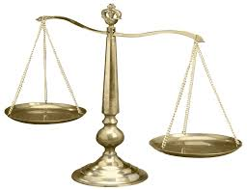
Laws in Canada
People with speech and language disabilities have the same rights as everyone else
This includes the right to equal access to goods, services and opportunities

Slide 10
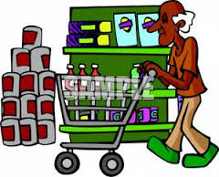
Access to Services
Businesses and organizations have responsibilities to make their services accessible to people who have speech and language disabilities

Slide 11
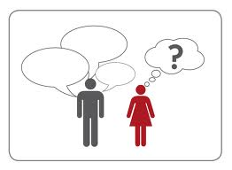
Communication access means that people can…
Understand what you are saying…
Most people can understand everything you say.
If a person has difficulty, try using:
Everyday language
Show objects, pictures and diagrams
Avoid jargon and terminology

Slide 12
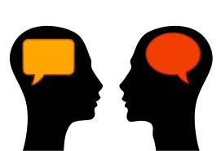
Communication access means that people can…
Expect that you understand their messages….
Ask the person:
Is there anything I can do when communicating with you?
Follow their instructions

Slide 13
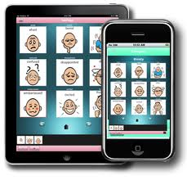
Communication access means that people can…
Use the communication methods that work best for them….
Accept whatever methods the person uses. It could be speech, gestures, writing, pointing to objects or pictures, spelling words, typing on a communication device or human assistance.

Slide 14
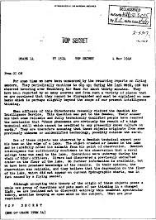
Communication access means that people can…
Read and understand your written information…
Ask the person:
Do you need assistance reading or understanding our materials?

Slide 15

Communication access means that people can…
Sign your documents and complete forms in ways that are accessible for them…
Ask the person:
Do you need assistance completing our forms?
How would you like to sign the form?

Slide 16
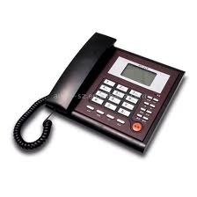
Communication access means that people can…
Contact you by phone, TTY, relay, email or text…
Ask the person:
How would you like to contact us?

Slide 17
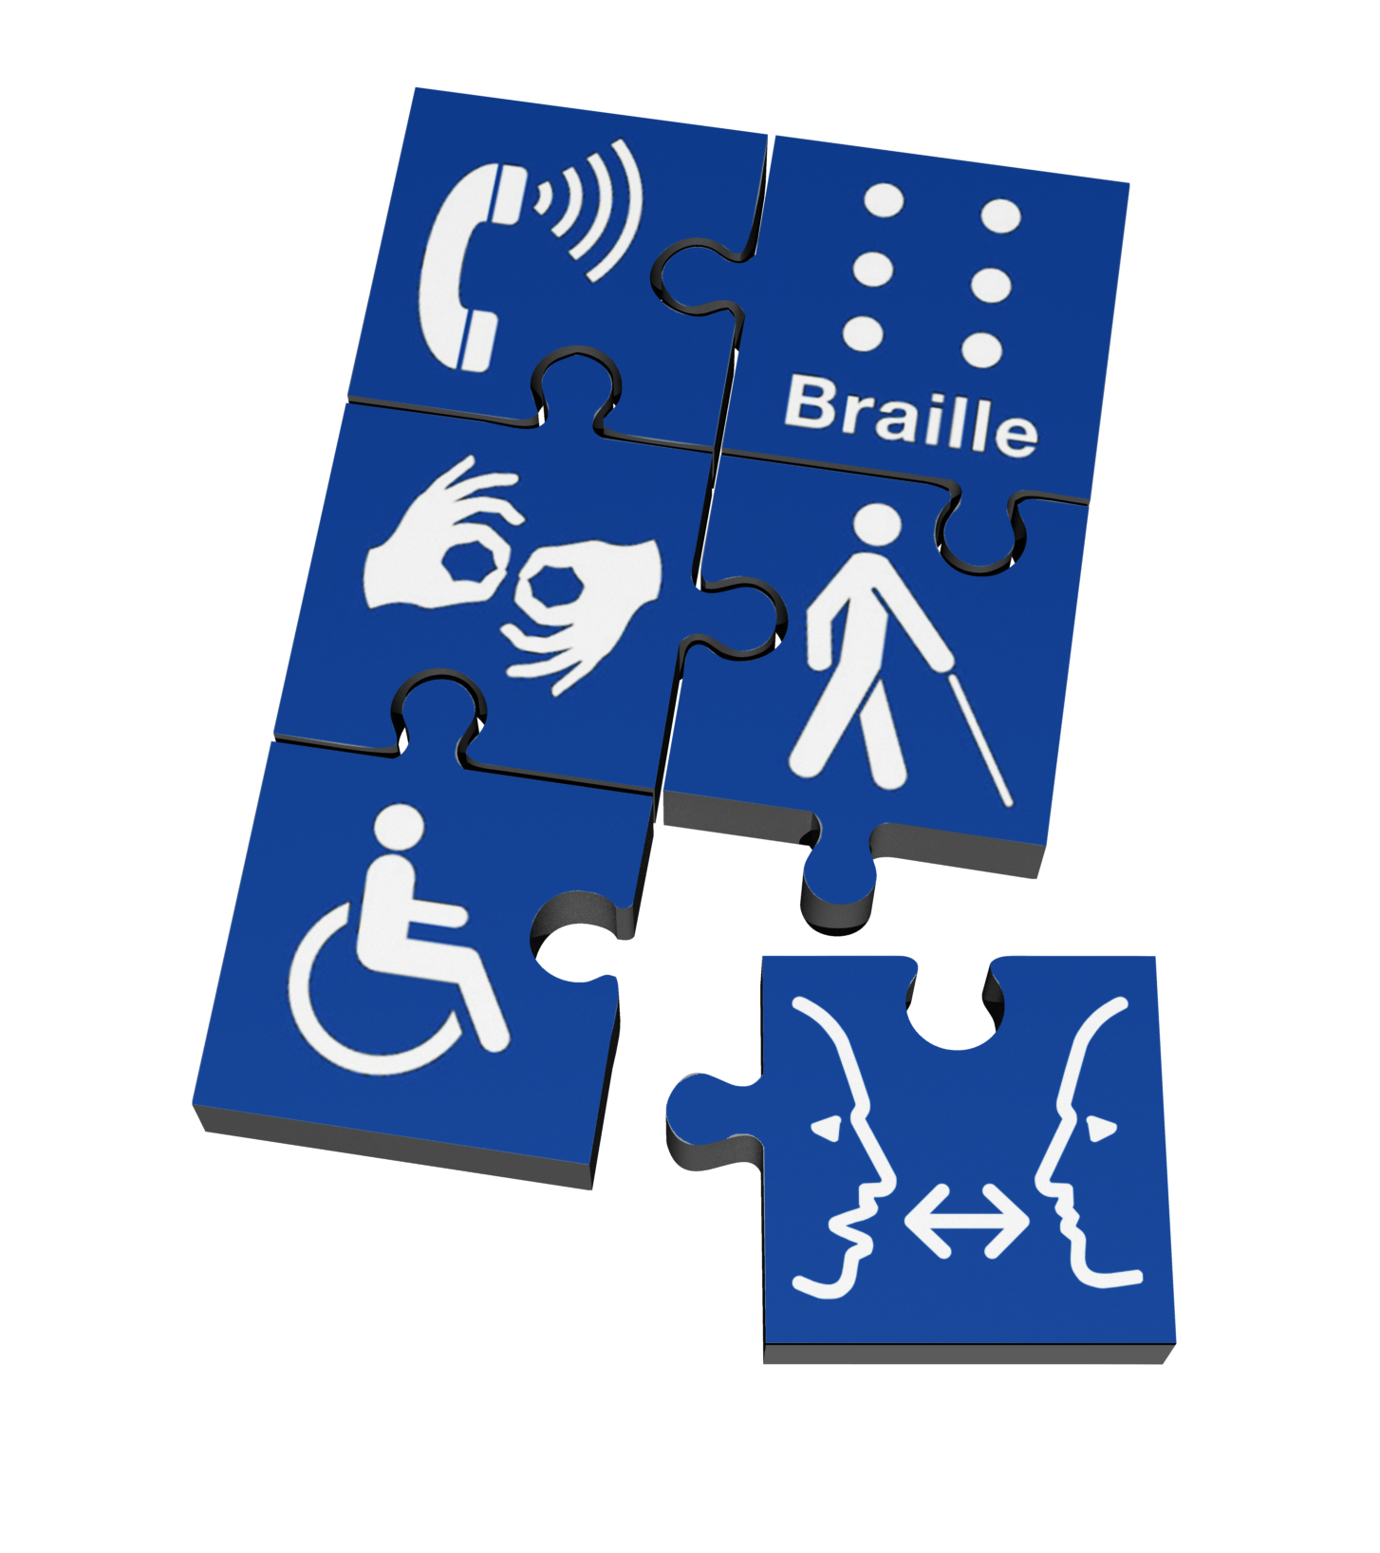
Communication access means that people can…
Interact with you
Communicate with you over the phone or use another way of contacting you
Participate at your meetings and public events

Slide 18
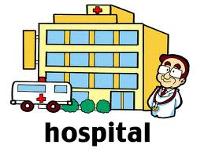
When Communication is critical…
Health care, emergency, police, legal, and justice services, require
Communication protocols
Staff who know how to communicate
Access to communication assistance services
Emergency picture, alphabet boards and communication tools

Slide 19
What Can You Do?
Put the Communication Access Symbol in your window
It tells people that your organization cares about communicating with your customers, patients and clients

Slide 20
What Can You Do?
Learn more ways to make your services communication accessible
Take CDAC’s free e-learning modules and get a certificate of attendant
www.communication-access.org

